Slide 1
By ADELAKUN ADEDOYIN WURAOLA PROBLEM STATEMENT: The data is for company X which is trying to control attrition. There are two sets of data: Existing employees and Employees who have left. Satisfaction level, last evaluation, number of projects, average monthly hours, time spent at the company, whether they have had a work accident, whether they have had a promotion in the last 5 years, departments, salary, whether the employee has left.
HASH ANALYTIC INTERNSHIP PROJECT REPORT

Slide 2
OBJECTIVE
What type of employees are leaving
Determine which employees are prone to leave next.
Present results with accuracy scores and with various plots.

Slide 3
DATA PREPARATION
The data set was given in two formats: Existing Employees and Employees who had left.
I created a new attribute, Attrition, for each setting Attrition=Yes for employees who had left and Attrition=No for existing employees.
I then merged the two data set which gives out 11 attributes with 14999 observations without any data missing.

Slide 4
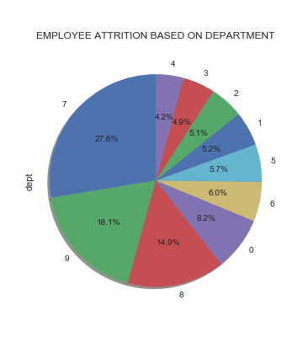
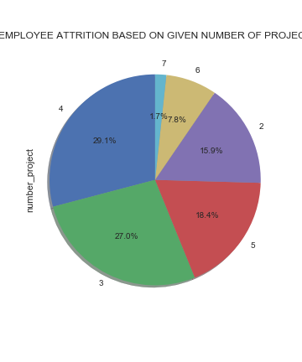
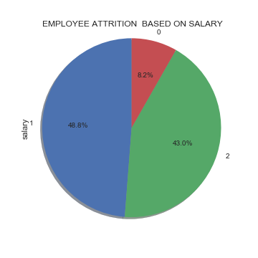
VISUALISATION
I analysed the categorical values using Pie charts and the continuous values using Violin plots.

Slide 5
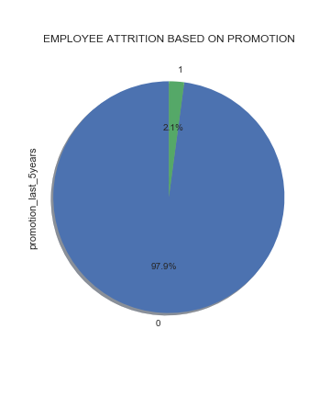
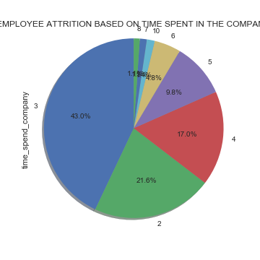
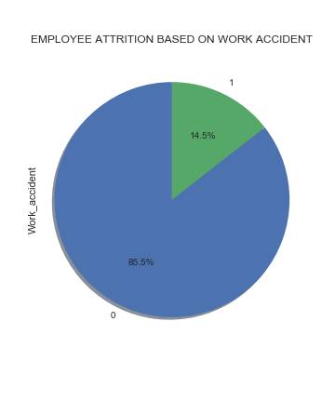
VISUALISATION

Slide 6
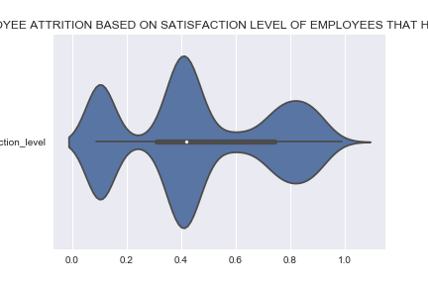
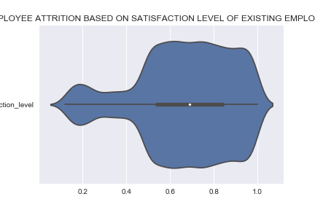
VISUALISATION
DATA VISUALIZATION

Slide 7
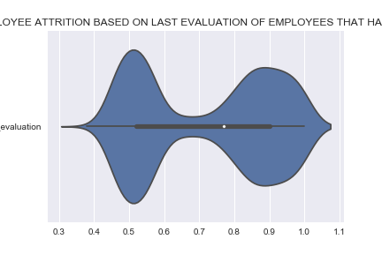
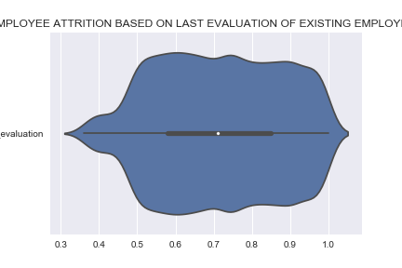
VISUALISATION

Slide 8
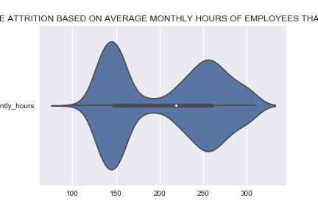
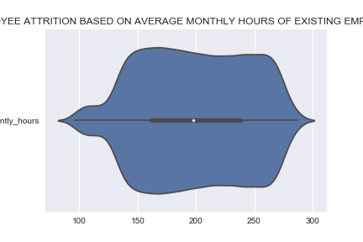
VISUALISATION

Slide 9
BUILDING THE MODEL
I separated the features and target, that is, the dependent and independent variables. The target here is attrition.
I splitted the data into training and testing set by a ratio of 0.30. Then I imported the Random Forest Classification library using the sci-kit learn.
Validating the model, I got an accuracy of 99%.

Slide 10
CONCLUSION
It is seen that employees with medium salaries are prone to leave next.
It is seen that employees that will spend 2, 3 and 4 years are prone to leave next.
97.9% of the employees who had left the firm were given late promotions.
The lesser the number of work accidents, the longer the employees will stay
Most of the employees who had left the firm were given less number of projects to work on.

Slide 11
CONCLUSION
It is also seen that more number of present employees have a higher satisfaction so medium satisfaction level employees are prone to leave.
The employees who had left were spending comparatively less time per month, employees spending more time per month are still working in the firm.
Employees with higher last evaluation scores are still working in the firm.

